Slide 2
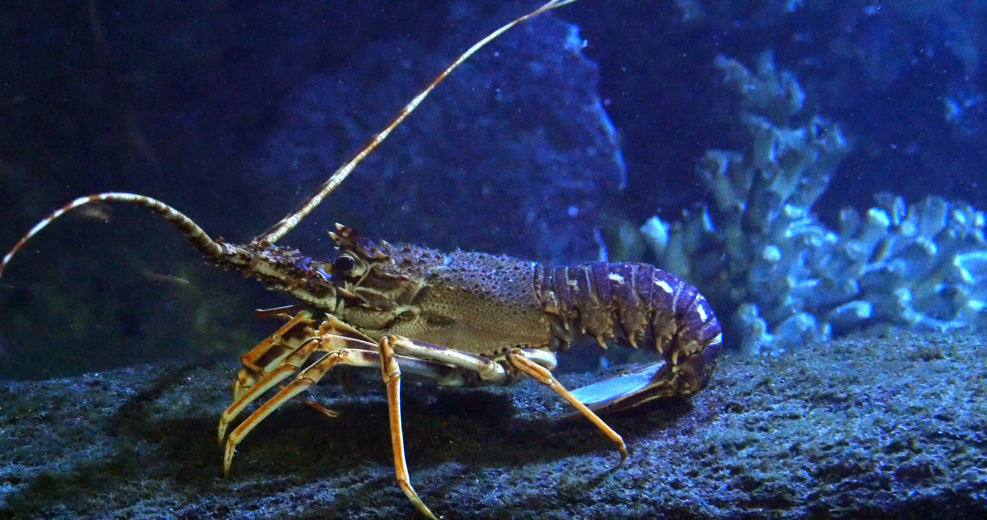
Langust. Foto: iStock/slowmotiongli

